Slide 1
Methodology
Models | Detail
Logistic Regression | Logistic regression is the appropriate regression analysis to conduct when the dependent variable is dichotomous
K-Nearest Neighbors | KNN model is to find the K value. In general, a larger k suppresses the effects of noise, but makes the classification boundaries less distinct.
Gaussian Naive Bayes | The Naive Bayes classifiers are working based on the Bayes’ theorem, which describes the probability of an event
Adaboost | Adaptive boosting creates a highly accurate prediction rule by combining many relatively weak and inaccurate rules.
Random Forest | Random Forest use the bagging idea, it resamples the data and features which will decrease the variance in the model
Support Vector Machine | SVM used to solve linear or non-linear problem which is a discriminative classifier
XGBoost | XGBoost is an implementation of gradient boosted decision trees designed for speed and performance
LightGBM | LightGBM uses Gradient-based One-Side Sampling (GOSS) to filter out the data instances to split value
Notes:
KNN is a lazy learning algorithm which doesn’t perform well with high dimensional data, it becomes difficult to calculate the distance, hence it’s reasonable to get such low accuracy score with our 69 features. In addition to the mean error rate = 0 when K value between , adjusting k value would influence the accuracy.

Slide 2
Home Credit Default Risk Prediction
Supervised Machine Learning Method
Chia Yi Liaw, Mounica Subramani
Sharyu Deshmukh, Somya Bhargava
Notes:
Hello class,
my name is ChiaYI , with my teammate Mounica, Sharyu and Somya,
Today, we are presenting the Home credit default risk prediction project, using

Slide 3
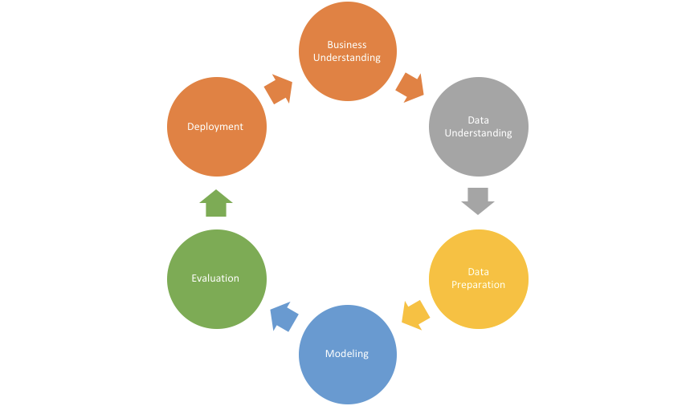
Table of Content
Abstract
Business Understanding
Data Understanding
Data Preparation
Modeling
Evaluation/Result
Discussion
Future Work
Notes:
Amy
cross-industry process for data mining

Slide 4

Abstract
Home Credit is a finance provider that focuses on serving the unbanked population. Many people struggle to get loans due to insufficient or non-existent credit histories. And, unfortunately, this population is often taken advantage of by untrustworthy lenders.
The Home Credit Default Risk challenge is a standard supervised machine learning task where the goal is to use historical loan application data to predict their clients’ repayment abilities based on datasets provided.
Notes:
amy
Home Credit B.V. is an international non-bank financial institution founded in 1997 in the Czech Republic and headquartered in Netherlands.

Slide 5
Business Understanding
Objective :
Ensure the clients’ capable of repayment aren’t rejected and the loans repayment calendar will empower the clients to be successful
Resources:
Testing and training datasets are available from Kaggle competition
Supervised: The labels are included in the training data and the goal is to train a model to learn to predict the labels from the features
Classification: The label is a binary variable, 0 (will repay loan on time), 1 (will have difficulty repaying loan)
Notes:
ensure that clients capable of repayment are not rejected and that loans are given with a principal, maturity, and repayment calendar that will empower their clients to be successful

Slide 6
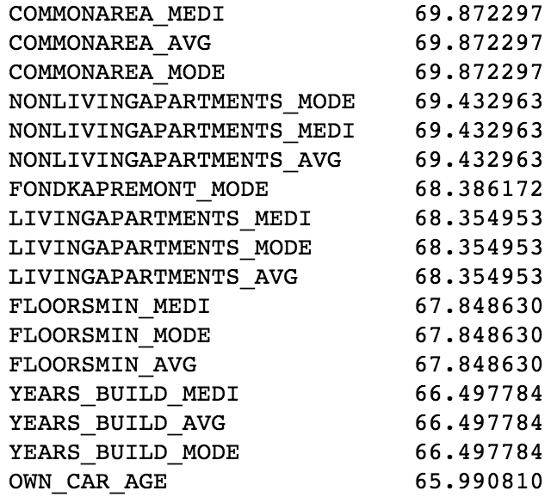
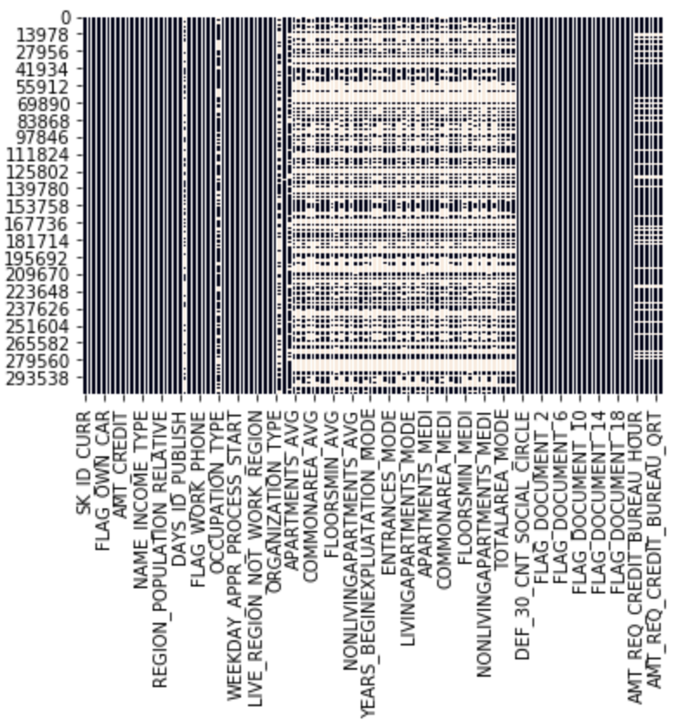
Exploratory Data Analysis
Missing Value
The Dataset contains 122 features with 307511 entries. we found out that missing value is concentrated in several features.
In addition, there are 17 features contain more than 60 percent of missing value. Imputation and deletion will be performed in the data pre-processing stage.
Percentage of missing value
Missing Value Map
Notes:
Amy Data Understanding
The Dataset contains 122 features with 307511 entries. As the respect of missing value,
The distribution map gives better evaluation and understanding of missing data
Which we found out that missing value is concentrated in serveral features
. From the visualization,

Slide 7
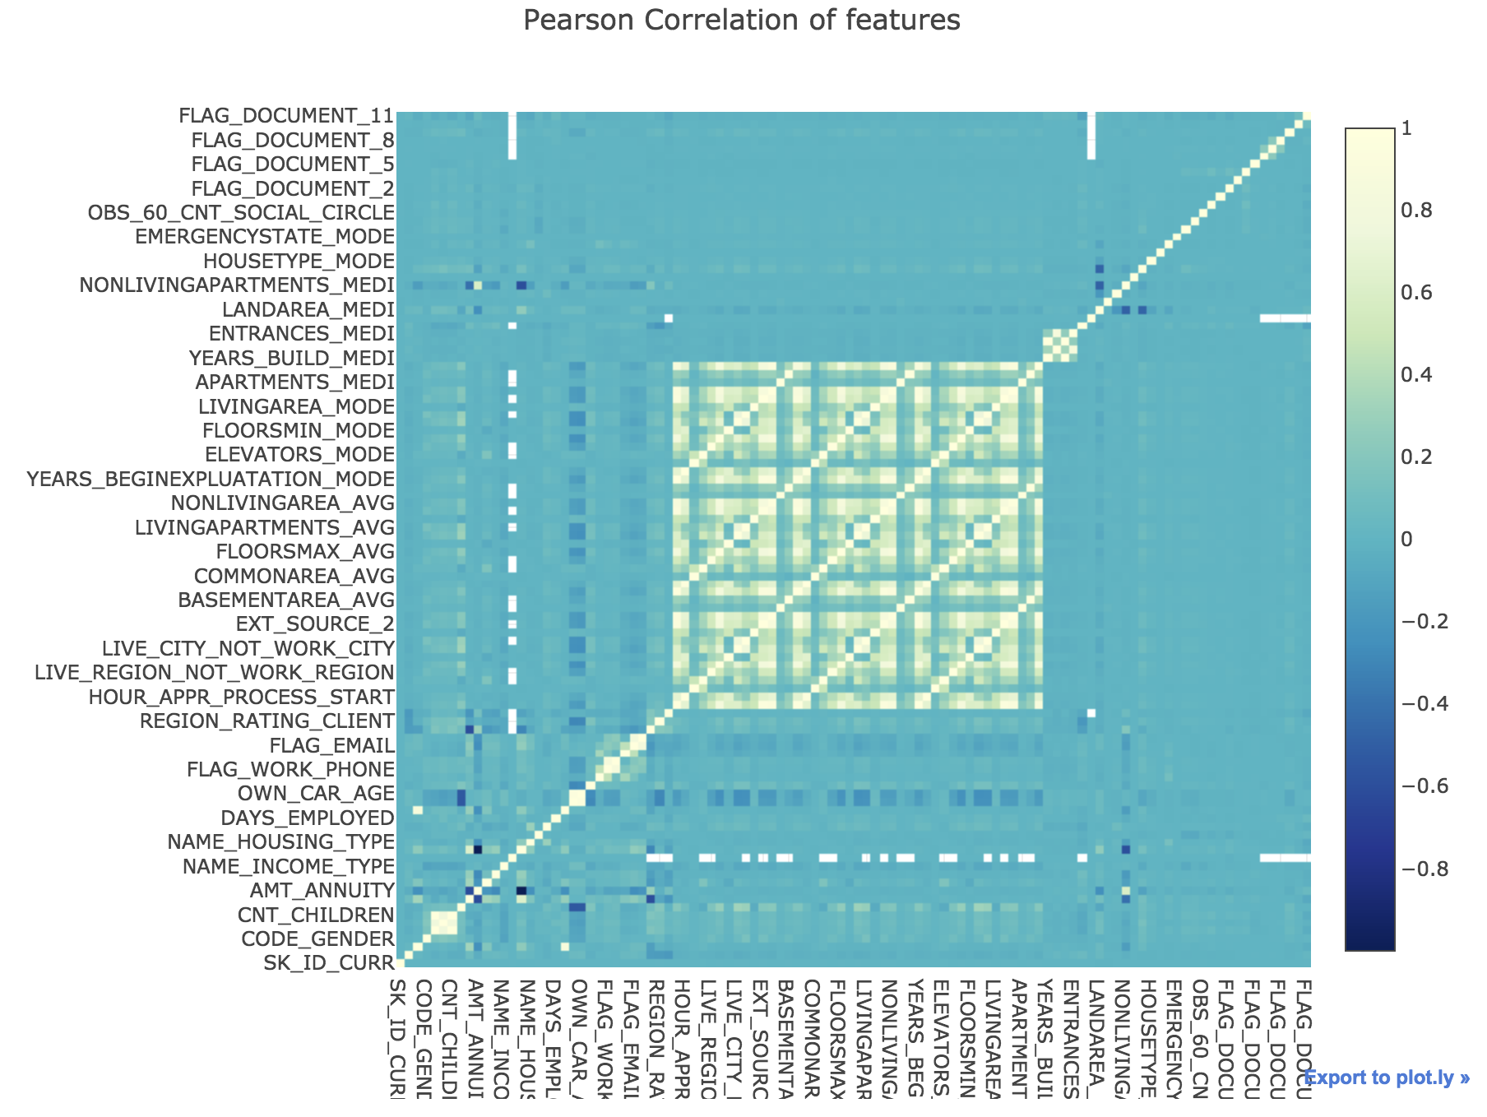
Exploratory Data Analysis
Feature Correlation
Pearson feature correlation quantifies the degree to which a relationship between two variables. By analyzing correlation feature, we implement the random forest method and LightGBM to improve calculation efficiency. Pearson correlation heat map shows the correlation between predictors, the lighter green indicates the higher correlation.
Feature Correlation Map
Notes:
Amy\
By calculating the r-square to determine the linear correlation between features.
Next I will pass it to Mounica to disucss the Data Preprocessing part

Slide 8
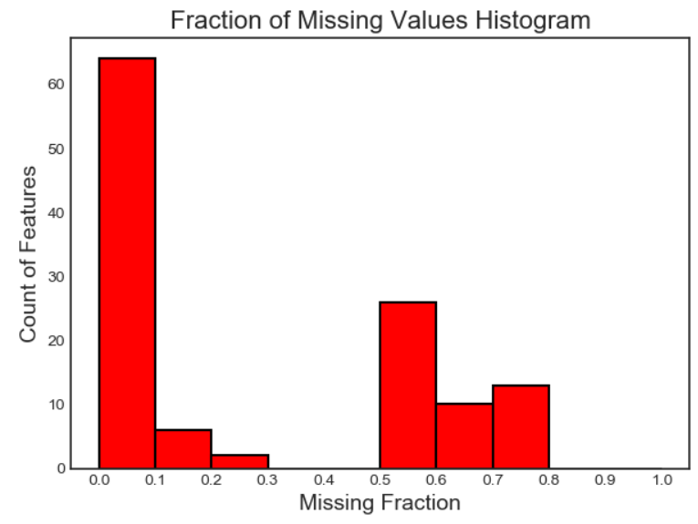
Data Preprocessing
Feature Selection
With the risk of high dimensional dataset and to reduce the variance of the model or chances of overfitting.
Missing Value : there are 23 features contain more than 60% missing value, hence we decide to remove those features as it’s not suitable for training models.
LightGBM : removes the features that are collinear, low_importance and zero_importance.
The outputs so generated are stored in csv format so that we can train them all and compare the results.
Notes:
Mounica\ If the number of features are very large in the dataset, it is like a noise to the dataset. To reduce overfitting, complexity of the model, to improve accuracy of the model and to enable the machine learning algorithm to train the dataset faster we will implement feature selection on the data set. We are taking FeatureSelector class to implement certain methods like identify the missing, identify collinear, zero and low importance.

Slide 9
Data Preprocessing
Encoding the Categorical Variable
One hot encoding for multiple categories and
Label encoding for binary categorical features.
Imputation of Missing Value
After feature selection , There are still some columns with missing data. Hence, will impute the missing value with mode which is the most frequent value in the column, moreover, it would apply well on the categorical variable.
Notes:
Encoding transforms categorical features to a format that works better with classification and regression algorithm

Slide 10
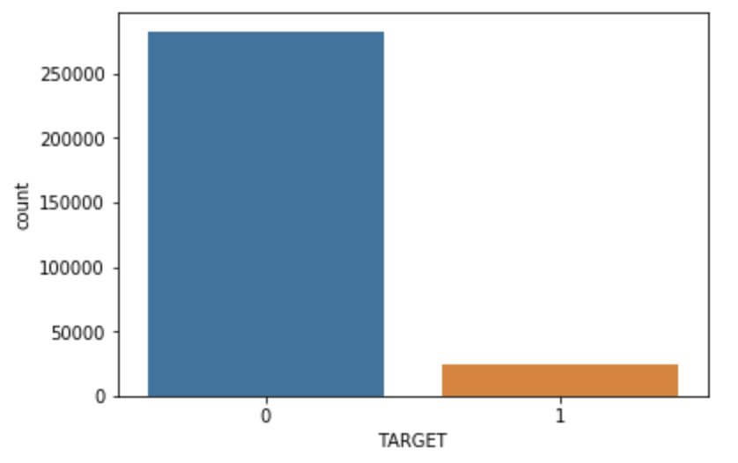
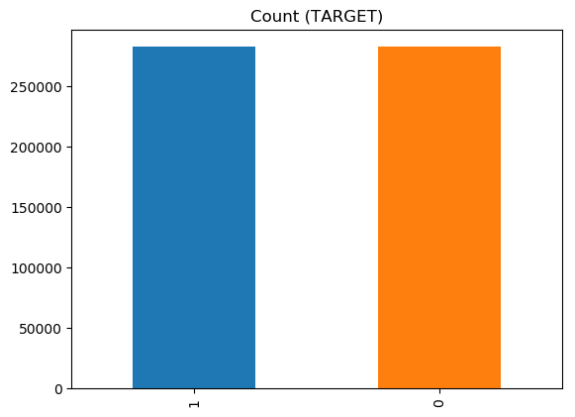
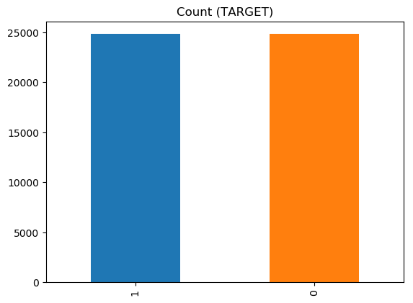
Data Preprocessing
Dealing with Imbalance Data
The below histogram show the imbalanced distribution of loan repayment in the dataset. The target variable defines if the loan was repaid by the borrower or not. From the graph, we find out that the data is highly imbalanced. Since, it might lead to incorrect result during modelling process, we needed resampling of the dataset. As a result, we have used both over and under-sampling to train the model. By looking at the evaluation, we will choose the better sampling method.
Distribution of original data
After oversampling method
After undersampling method
Notes:
Mounica\ Used to adjust the class distribution of a dataset.

Slide 11
Result
Models | Accuracy Score | ROC Score | Precision | Recall | F1 Score
Logistic Regression | 0.665 | 0.665 | 0.67 | 0.65 | 0.66
K-Nearest Neighbors | 0.554 | 0.554 | 0.52 | 0.90 | 0.46
Gaussian Naive Bayes | 0.536 | 0.534 | 0.52 | 0.90 | 0.46
Adaboost | 0.676 | 0.676 | 0.68 | 0.67 | 0.67
Random Forest | 0.671 | 0.671 | 0.68 | 0.65 | 0.67
Support Vector Machine | 0.666 | 0.666 | 0.67 | 0.65 | 0.66
XGBoost | 0.685 | 0.686 | 0.682 | 0.682 | 0.682
LightGBM | 0.748 | 0.749 | 0.69 | 0.68 | 0.68

Slide 12
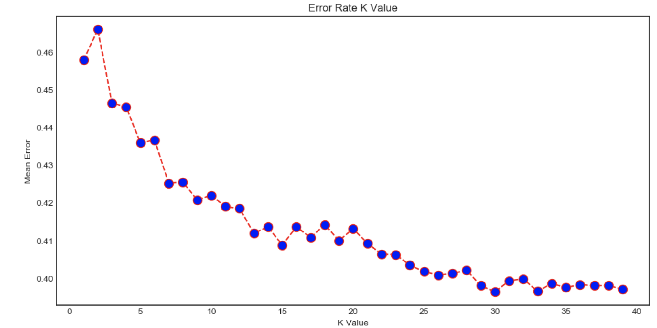
KNN choosing K value
In addition to the mean error rate = 0 when K value between , adjusting k value would influence the accuracy.

Slide 13
Discussion
We observed that LightGBM performs outstandingly as compared to all the other models. In general, it was observed that the tree based models are performing better on this dataset.
Consider a finance provider wish to evaluate the risk of loan repayment ability. Company would like to have a model with higher recall value rather than the Precision. Because company wants to make sure the clients are able to repay the loan based on given operation data.
Meanwhile, the precision cannot be below a threshold to make sure the Home credit will not take every loaner as a person who can’t have a consistent repay capability

Slide 14
Future Work
Perform manual feature engineering, make polynomial features and perform predictions based on them.
Collect more data about our features in order to train the model better
Perform Stacking/Blending for improved accuracy
Evaluate the performance of three different models on validation set using their precision, recall and f1-score.

